Slide 1

The historical archive of over 100 years of ‘the newspaper that rules Britain’
Daily Mail 24 July 2004, p. 1

Slide 2
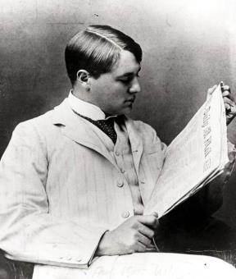
“I knew from the first just what people wanted to read.
Three things which are always news
– health, sex and money”
Lord Northcliffe, founder of the Daily Mail

Slide 3
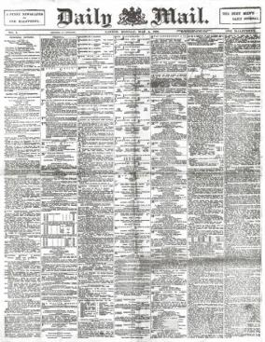
“A penny newspaper for one halfpenny”
The Daily Mail brought the news for the first time into the homes of millions, many of whom had never bought a newspaper before.
Coined the phrase “tabloid” – a chemist’s term for a small effervescent pill.
“The busy man’s paper. All the news in 60 seconds”
1st issue of the Daily Mail 4 May 1896

Slide 4

Key Features of the Daily Mail Historical Archive
A complete run from 1896 – 2004, including over 1.2 million pages, 34,000 issues and over 12 million articles, including the rare Atlantic Edition
Full text and keyword searchable
Cross searchable with other Gale products via

Slide 5
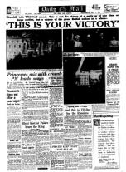

A Resource for History:
Provides detailed articles recording public reactions to key historic events including:
The Rise of Fascism in Europe
The End of both World Wars
The Coronation of Queen Elizabeth
The Falklands War
The Government of Tony Blair
Daily Mail Wednesday May 9
1945, p. 1
Daily Mail Friday May 02 1997, p. 1

Slide 6
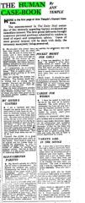
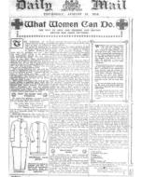
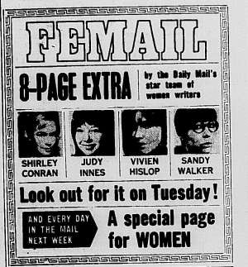
Women’s Issues
The Daily Mail launched the first ever ‘Agony Aunt’ column in 1936, with Ann Temple’s ‘Human Case-Book’
Although owned and edited by men, the Daily Mail’s has always considered women as its primary audience
In 1968 it launched the first supplement in a major newspaper devoted entirely to women
Daily Mail, Friday February 7, 1936, p. 8
Daily Mail Thursday August 13 1914, p. 1
Daily Mail Friday October 25 1968, p. 1

Slide 7
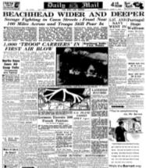
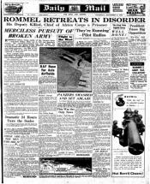
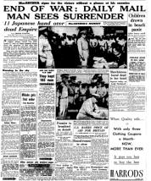
World War II
Daily Mail, June 7 1944, p. 1
Daily Mail, November 5 1942, p. 1
Daily Mail, September 3 1945, p. 1

Slide 8
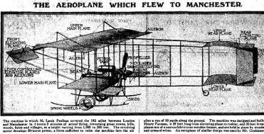
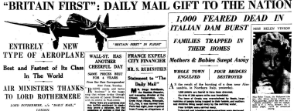
History of Aviation
The Daily Mail played a unique role in championing the new technology of flight
Sponsored a £10,000 prize for first flight from London to Manchester (won in 1909), and across the Atlantic (won in 1919)
Amelia Earhart and Amy Johnson reported exclusively for the Daily Mail
The Daily Mail commissioned the Bristol Blenheim, a powerful bomber that played a crucial role in WWII.
Daily Mail, 29 April 1910, p9
Daily Mail, 14 August 1935, p11

Slide 9
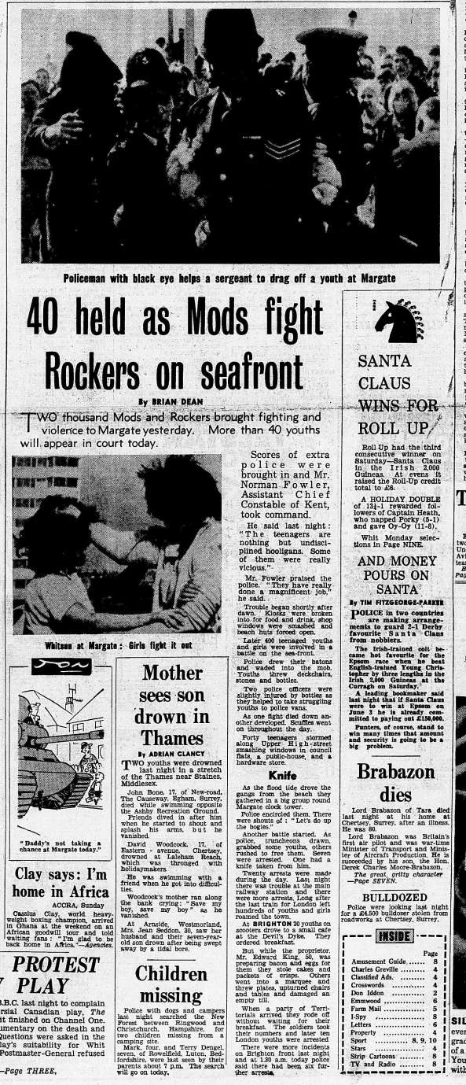
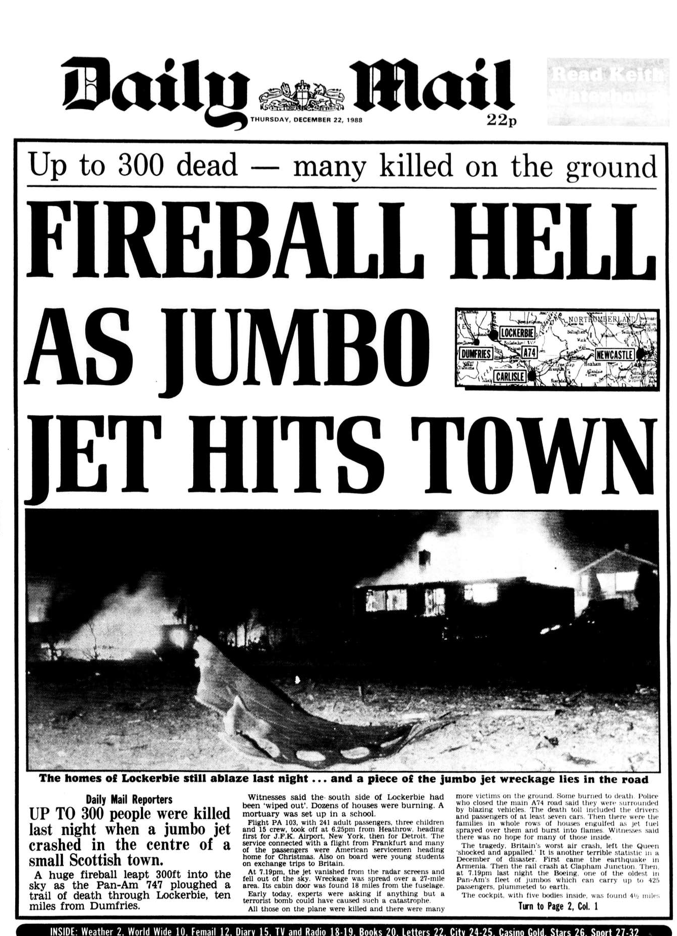
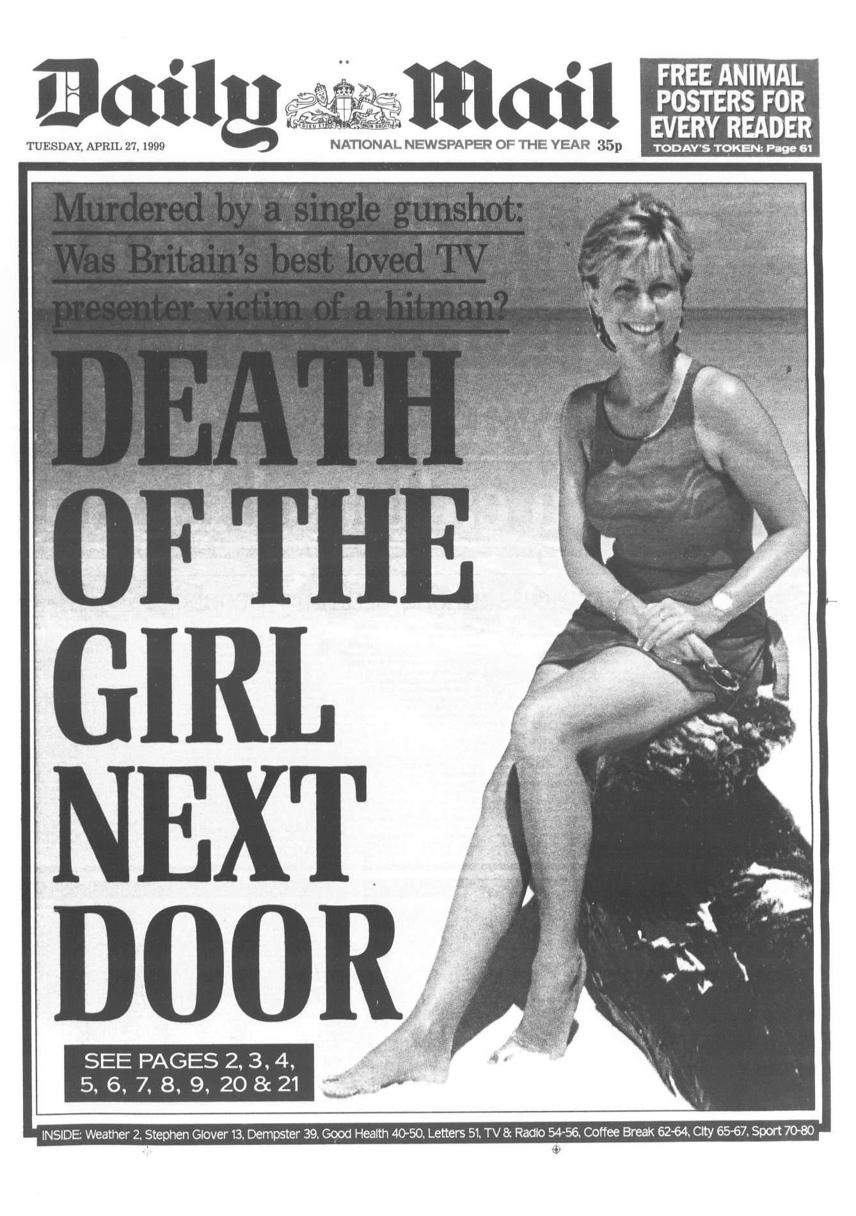
Crime
Teenage gang violence: Mods vs Rockers
Daily Mail, May 18 1964, p. 1
The Lockerbie Bombing
Daily Mail, December 22 1988, p. 1
Murder of Jill Dando
Daily Mail, April 27 1999, p. 1

Slide 10
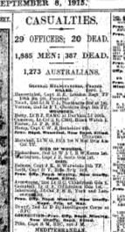
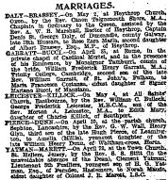

Family History
Daily Mail, 27 January 1900
Daily Mail, 8 September 1915
Daily Mail, 8 May 1896

Slide 11
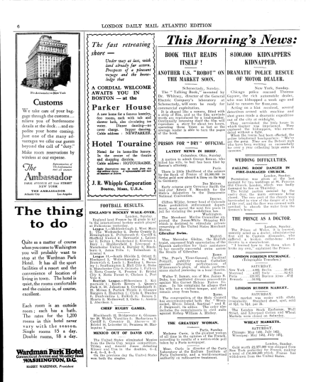
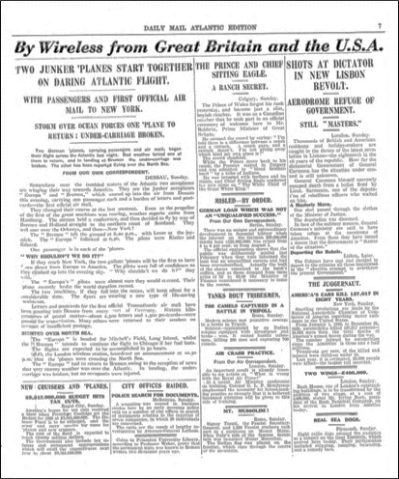
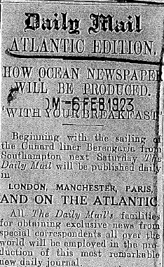
The Daily Mail Atlantic Edition:
Published on board transatlantic liners, 1923-1931
News was sent to the ship by wireless and the paper was assembled each night of the 5-day voyages
These rare issues are not held in any major libraries

Slide 12
Product Features

Slide 13
Product Design and Functionality:
Homepage with basic search
Advanced Search
Results page
Page Display with specifically developed viewer
Browse by Date
Search History
Marked Items

Slide 14
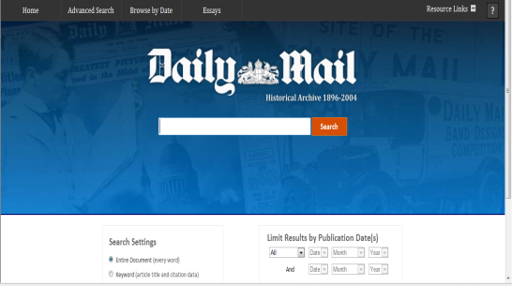
Homepage:
Navigation
Basic Search
Keyword/Entire Document and Limit by Date

Slide 15
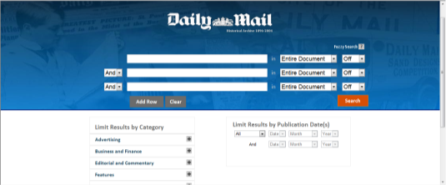
Advanced Search:
Fuzzy search looks for words similar to the specified term, in case the spelling has changed over time
Limit the search by date, section or article type
Keyword or phrases search in Entire Document, Article Title, Author, Day of the Week, Page Number, Issue, Keyword, Document Number

Slide 16
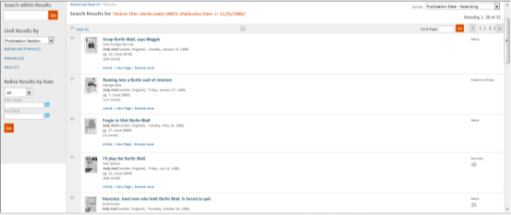
Results:
Results can be sorted in ascending, descending order or by relevance
Results can be limited by publication section and article type
Search within results, start a new search and flags to mark items
From each thumbnail choose between Article, View Page and Browse Issue

Slide 17
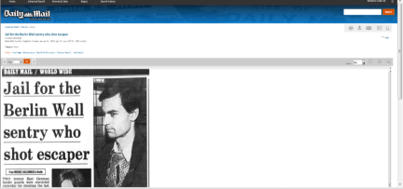
Page Display:
Article Title and publishing information
Change the view of the article in order to see the entire page or issue
Zoom options and page number
Search within article or issue
Print, Download/Save, E-mail, Cite and Bookmark the article

Slide 18
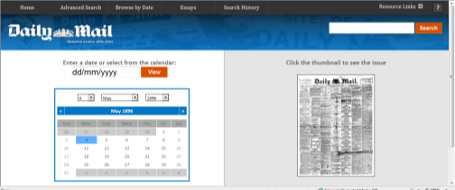
Browse by Date:
The date of the issue can be specified using the calendar
A thumbnail image of the front page of the issue from the specified date automatically appears. Click on the thumbnail to view it.

Slide 19
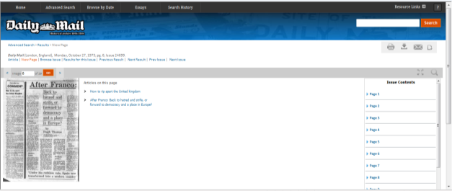
Issue Display/Results:
Image of the front cover of the issue with the articles on the page listed and linked
Scroll through Issue Contents in order to select a specific page

Slide 20
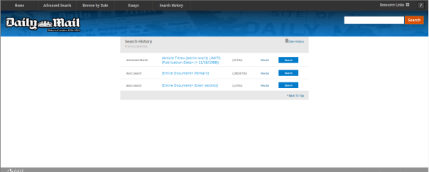
Search History:
Enables the user to revisit and revise previous searches

Slide 21
Conclusion

Slide 22
Key Facts:
•Offers over 6.7 million articles
•An essential resource for a large range of disciplines, including politics, history, science and the arts
•Includes the rare Atlantic Edition (1923-1931) and Special Issues from the Paris Peace Conference (1919), George V’s Silver Jubilee (1935) and more.

Slide 23
To register for your free trial or request further information please contact us:
Email: emea.marketing@cengage.com
Visit: http://gale.cengage.co.uk/dailymail
Call us: +44 (0)1264 332424

