Slide 1

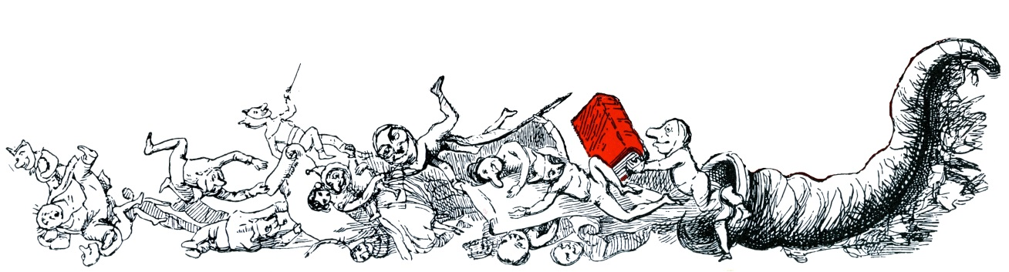

Presenting over 150 years of history, satire and humour, as recorded in the pages of Punch magazine
Historical Archive 1841-1992

Slide 2


Key features in the Punch Historical Archive:
A complete run from 1841 – 1992, including 188,455 pages, 8,520 issues and 347,892 articles
Fully text searchable
Previously hidden author names are transcribed from the Punch ledgers and anonymously written articles are discoverable through an author search
All special issues, Almanacks, Indexes, preliminary material and Seasonal Numbers can be found alongside regular, weekly issues
Available to cross-search with other Gale products via

Slide 3
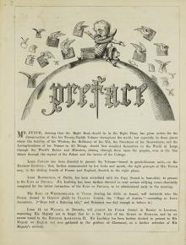
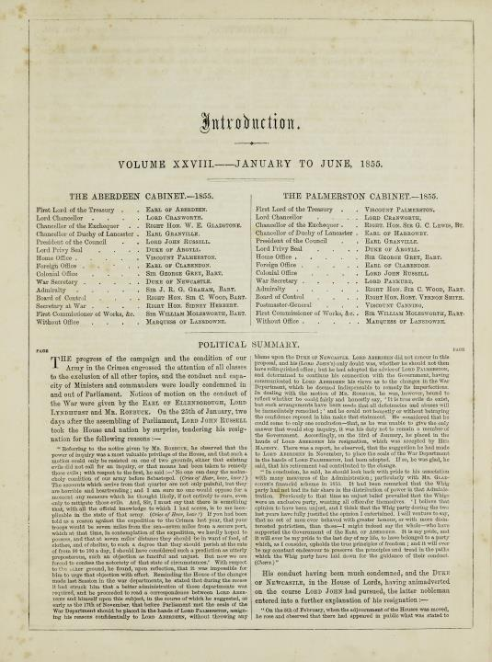
1855 Volume Prelim
1855 Preface
Preliminary Content
From 1842 until 1901, each volume of Punch included Preliminary Content, such as Introductions, Title Pages and Prefaces. These are labelled as ‘Prelims’ in the archive
  These include valuable information for the contemporary reader and researcher, as they set the context of the cartoons
  The Introductions describe the politicians and famous figures of the times, as well as outlining the key issues of the day
  The Preface provides a summary of what had taken place, typically set in a story or letter form
  After 1901, the Prelim exists only as a title page for the volume and, in 1950, ceases entirely
1855 Introduction

Slide 4
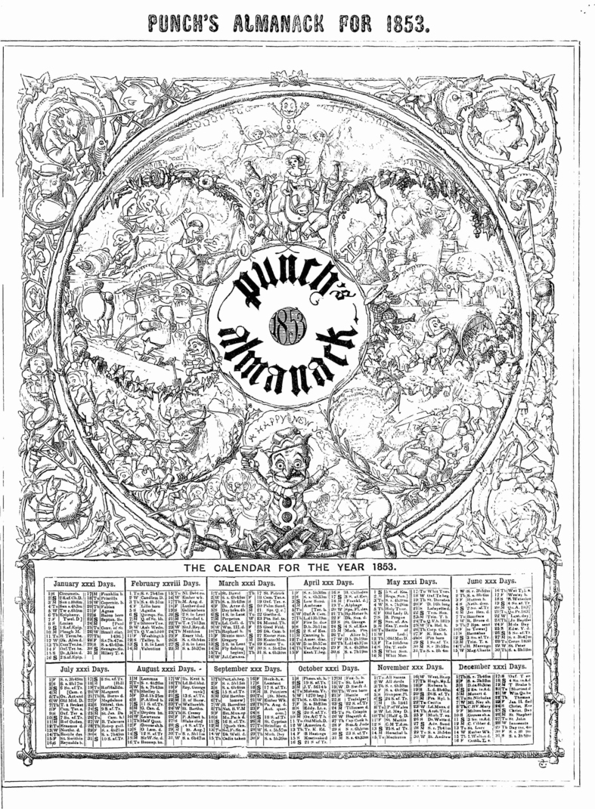
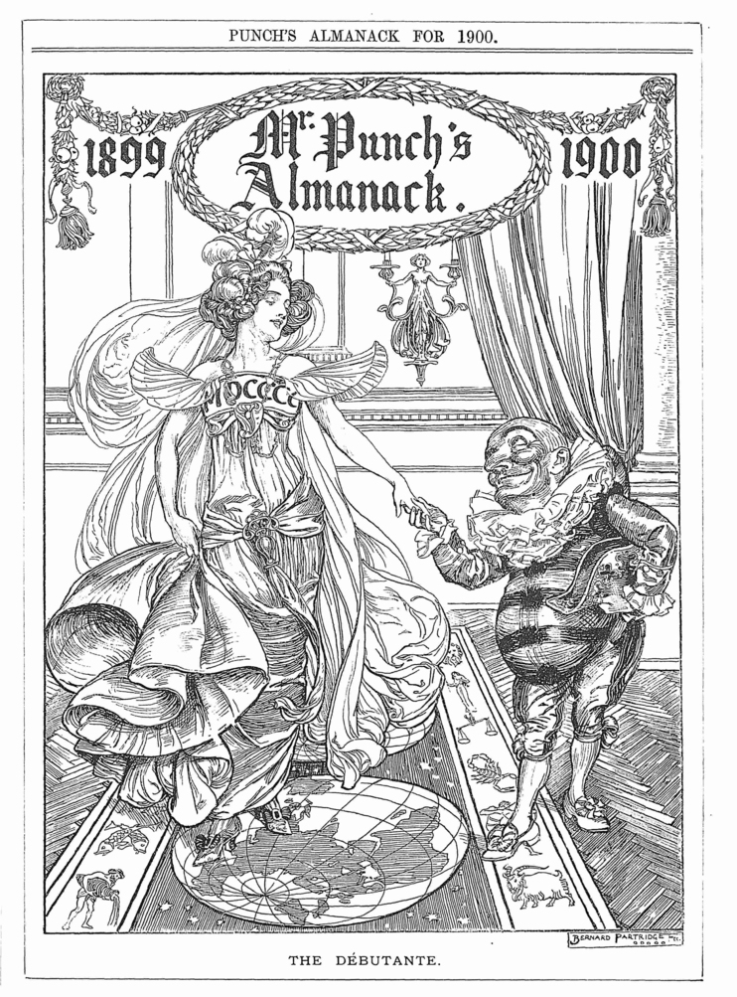
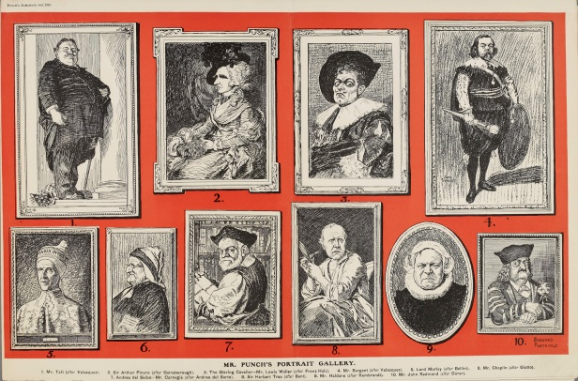
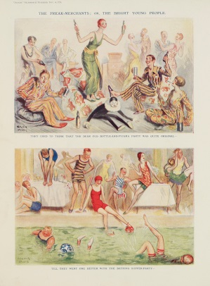
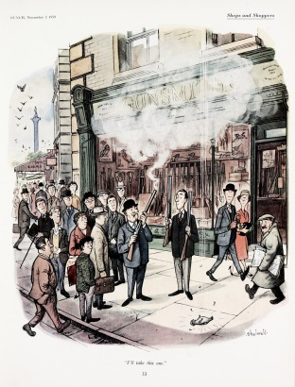
Almanacks
Published once a year, usually in November of the previous year (i.e. Almanack for 1931 was published in November 1930)
  included at the beginning of the corresponding year in the archive
  These were separate issues from the regular run and were a humorous review of the upcoming year
  Almanacks were the first issues to include colour in their publication, beginning with spot colour in 1910 and eventually full colour cartoons in 1921
1910 Almanack
1930 Almanack
1960 Almanack
1853 Almanack
1900 Almanack

Slide 5
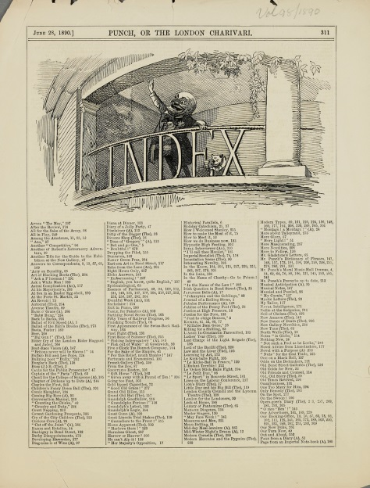
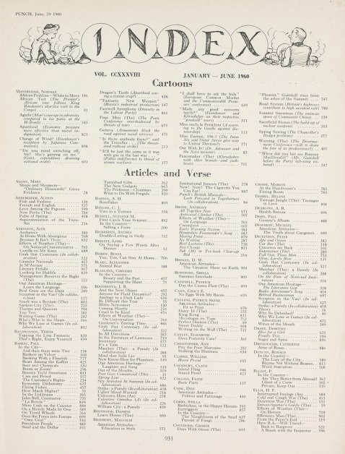
Index
Indexes appeared twice a year (at the end of every volume) from 1841-1987
Until 1902, these Indexes list the available articles in alphabetical order
From 1902 onwards, these became more in-depth and list articles by author, making it possible to identify anonymously written pieces
  The back of the index includes the names of all the artists in the volume with the page numbers of where their cartoons can be found
  The Big Cuts are listed by artist, and then by title, at the top of the first page
Jan-June 1890 Index
Jan-June 1960 Index

Slide 6
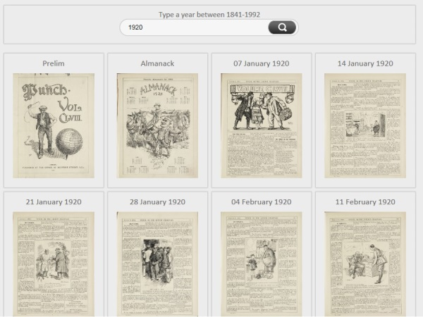
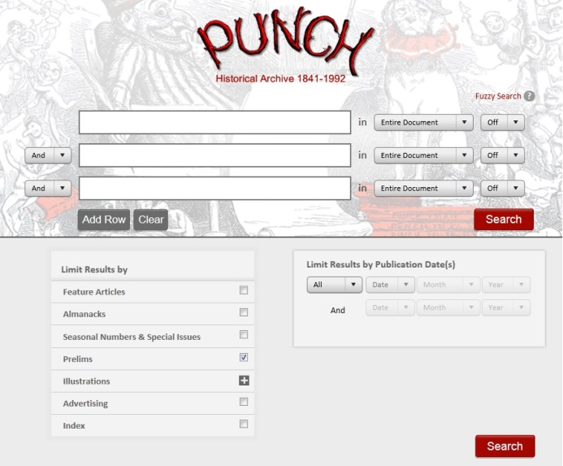
Browsing Preliminary Content, Almanacks and Indexes
There are two way to access the additional Punch content: through ‘Browse by Date’ and through ‘Advanced Search’
Select ‘Browse by Date’ from the top menu and enter the relevant year in the search box. The Preliminary Content appears as the first issue and again in the middle of the year, the Almanack once a year following the ‘Prelim’ and the Indexes first in the middle and then as the final issue
Select ‘Advanced Search’ from the top menu and select the relevant limiter which appears on the bottom half of the page. Conducting a search with just a limiter will result in all the issues of that one content type to appear. A year can be specified in ‘Advanced Search’ through the drop down boxes or on the Search Results page itself

Slide 7
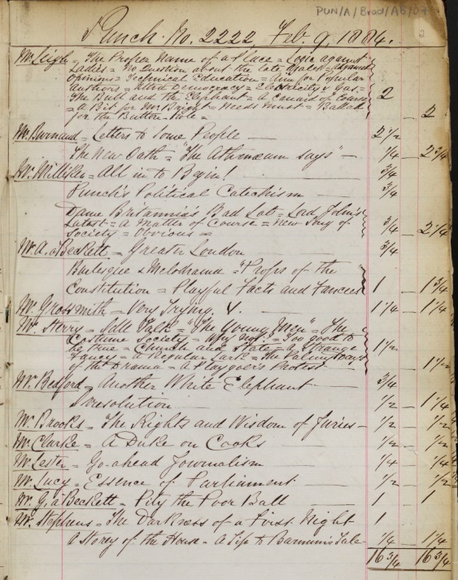

Ledgers
In the 19th century, and for much of the 20th, articles in Punch were published anonymously or pseudonymously
To fill in this knowledge gap, Cengage Learning has worked with a team at Liverpool John Moores University, headed by Dr Clare Horrocks, to transcribe Punch’s ledgers (editorial files) from 1843-1919, and integrate this metadata into the archive. The original ledger images can be seen at http://www.ljmu.ac.uk/HSS/124772.htm
This will be called out by an ‘Identified from Contributor Ledger’ label in the archive so users can understand the origin of author identification
Ledger Page
February 09, 1884

Slide 8
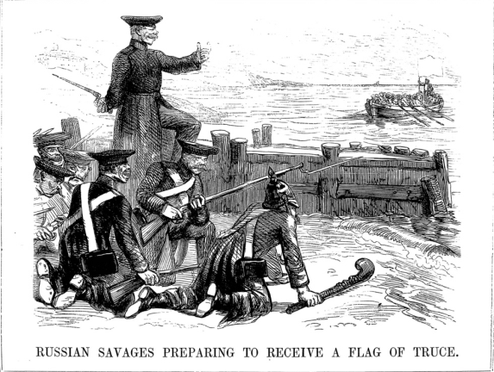
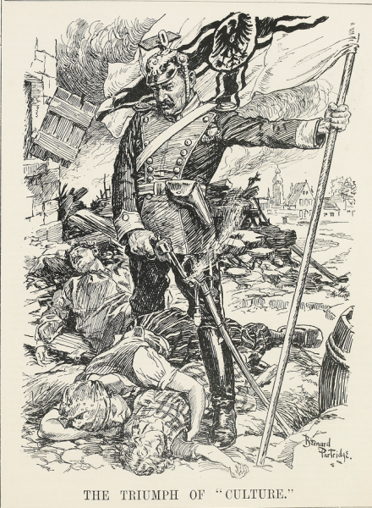
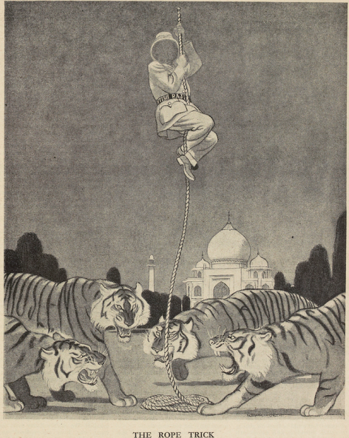
June 30, 1855
A Resource for History:
Provides detailed articles recording key historic events, including:
The Crimean War
The First and Second World Wars
The Arab-Israeli Conflict
Colonialism
Women’s Suffrage
August 26, 1914
May 28, 1947

Slide 9
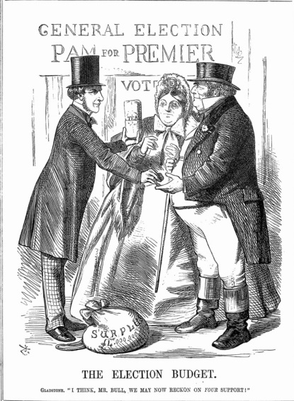
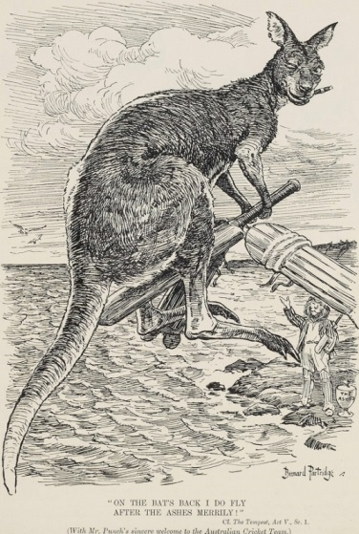
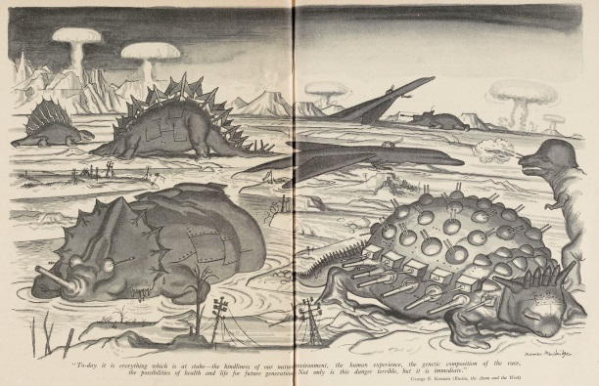
May 13, 1865
April 26, 1905
Punch also supports the study of topics such as:
Sports: Cricket, especially The Ashes between England and Australia
Social Change: The “Servant Problem”, Immigrations into the UK
Public Health and the Environment: Pollution, Smoking
New Technology: Cars, the Telegraph
March 05, 1958

Slide 10
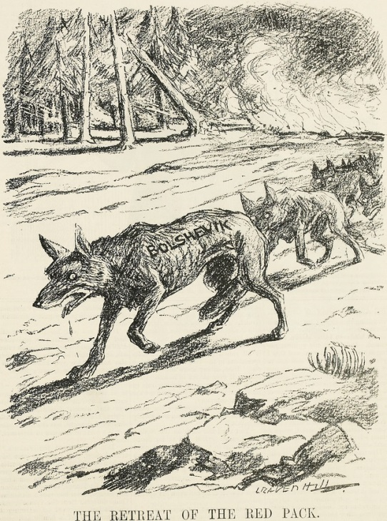
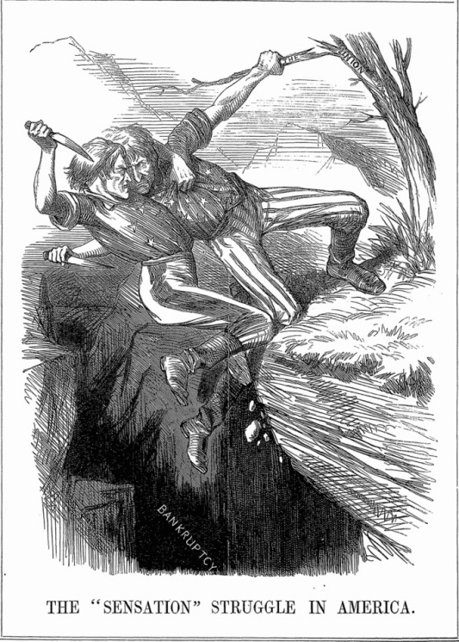
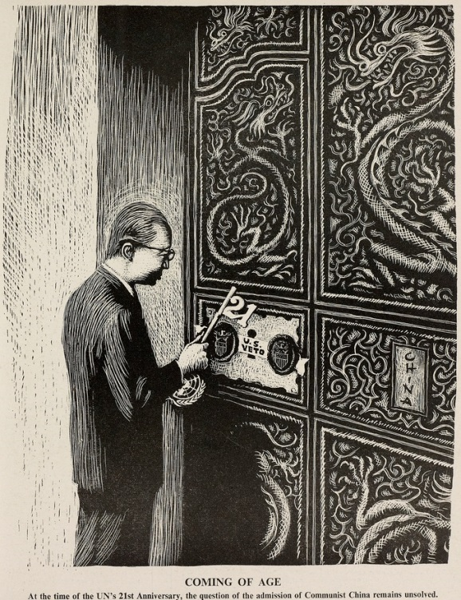
International Coverage:
America
June 07, 1862
China
October 19, 1966
Russia
October 22, 1919

Slide 11
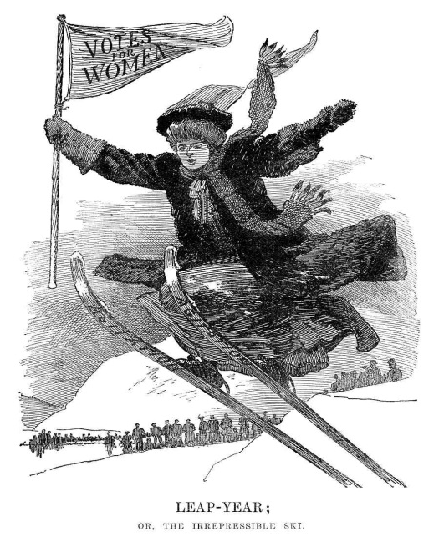
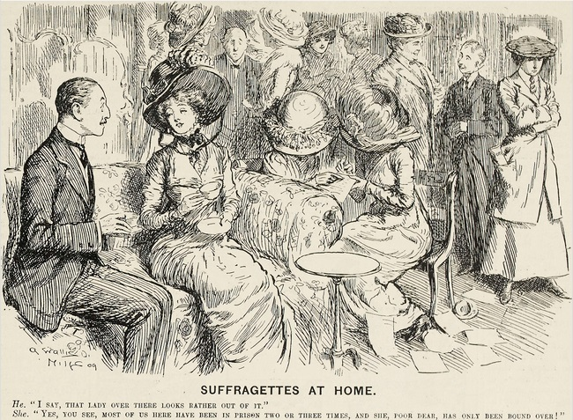
January 01, 1908
Punch as a Resource for Teaching and Learning:
The Women’s Movement and the Suffragettes as represented in Punch
A general search for “Suffragettes” will retrieve 247 results
Punch, while following the development of women’s rights, does insinuate that suffragettes themselves do not fully comprehend the situation
Questions for students:
  Do you think Punch supports or opposes the movement for women’s suffrage?
  Does Punch have a consistent view of the issue?
  How representative do you think Punch was of contemporary opinion?
April 14, 1909

Slide 12
If you have any questions or queries, please contact the Library Reference Publishing team:
Cornelia Lenz
Digital Product Editor
Cornelia.Lenz@cengage.com
Seth Cayley
Head of Research Publishing
Seth.Cayley@cengage.com

